Slide 1
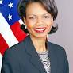
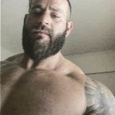
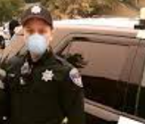
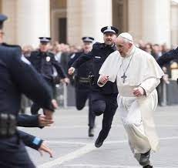
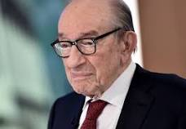

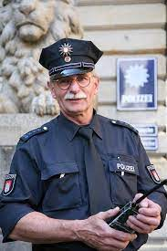
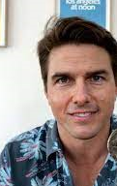
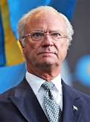
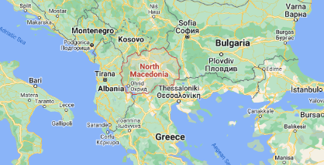
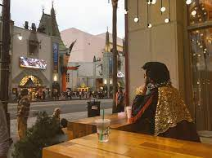
development
Immgration
War in Yugoslavia
docs
Immgration
Princpal
SQ.FBI.investgion(doors,coldwell jim)
IMPORT elvis
VRINGIA.MARY.POPE.FRNACEOC
PETERSSON.KING(dom cum)
Call you Dr. Rice; Mueller-Reiss
1997 Redhouse; redcrates; apple II used
1998 CPVA band Wonderbra’s, Elvis2
Immgration.nonPoliceIntutup.nonPocleiTriggers
2007/8 SQ
1998 WWI
CD parent lines
0.1 ich zesege dir den kopf (tranl) I will saw off you head: (parent)
0.1 mehr vodka als leven (tranl) more vodka than lemon
Status of father 1D8723.IPX. ATB
nonPolcieSexAbuse
- Sex with Elderly women 18/52
- Sex with anyone
- Invested (in sleint )Sex Internet
- nonPolcieInit.nonPoliceTrigger(“sex jokes, !sex jokes”)
Alen, Franceco, Stanford, Thomas
Alen, Franceco, Stanford, Thomas
Chim TERMIANOTRE.DR.JOESPEPH.nonPoliceRT
“Chim” Arim, Achim
0.01 nonPoliceCfgLogical(‘famous’).add(nonPoliceMovies).nonPoliceIntertupLogical

Slide 2

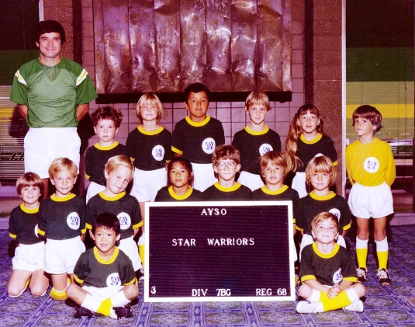
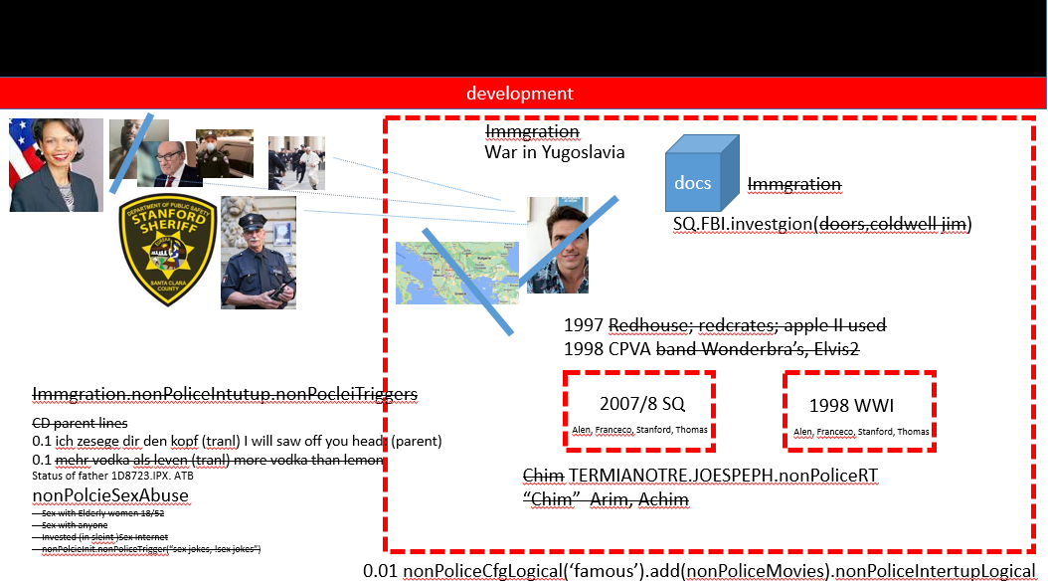
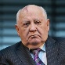
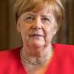
development
nonPolcieSexAbuse
docs
Immgration
CPVA.selector
1987.v1
docs
CPVA.selector
nonPolcieTRX.CPVA.v1
v2

Slide 3


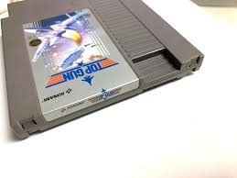
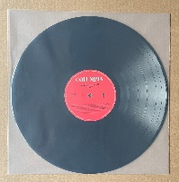
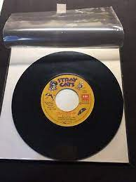
development
Borrowed:
do you sleve
Forgot the sleve? Box?
!barrdord 2016 wife()
August 17, 1990
War in Yugolslavia
Call you Dr. Rice -> 2014 CPVA call you Dr. Rice
01 ATOMCLOCK
2015 European migrant crisis
§!CPVA.VIRGINIA.eval
§DEA(cannabis)
§Public Disbahce
§Domestic Vioalicne
sleeve
record sleeve dirty
ATB cd stand ikea 1996
IMPORT ibm INTENRET PAYMENTS find her like a cat
Notes:
§

Slide 4

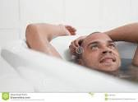
development
nonPoliceContentItem
Churchill/Elvis
nonPolcieChristmas
2010 FBI:WMD:GREEN(bathtub)
Gorbache(al-kaida New York, picture idea bridge IPX gheoh(seitz, town) 80”x80”)
sex with wife, while on way to work, might be father 9 months calculator
Stanford Medical (1.5M sperm count; 3M avg)
Tom Cruz nonPolciCfg.impotent
JFK(mr president)
Airplain tickets Dr dieter zechte(tui)
HOMCI:LUX:COINTTION(thoshi-is-dieter,tui, beathe Auschwitz:siemens)
Notes:
§

Slide 5
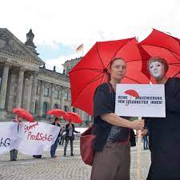
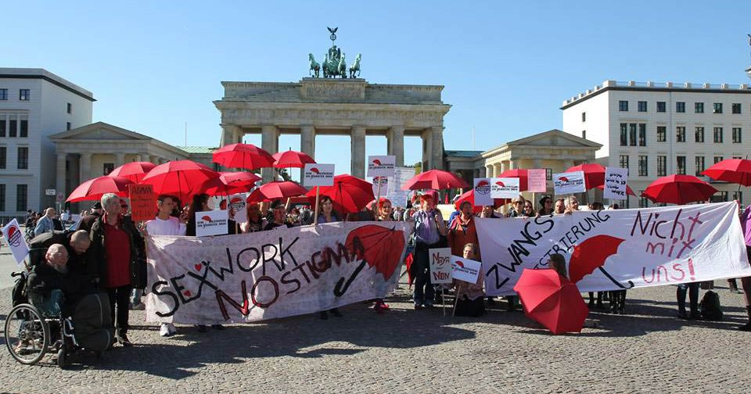
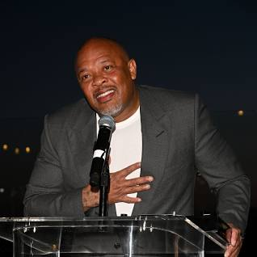
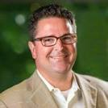
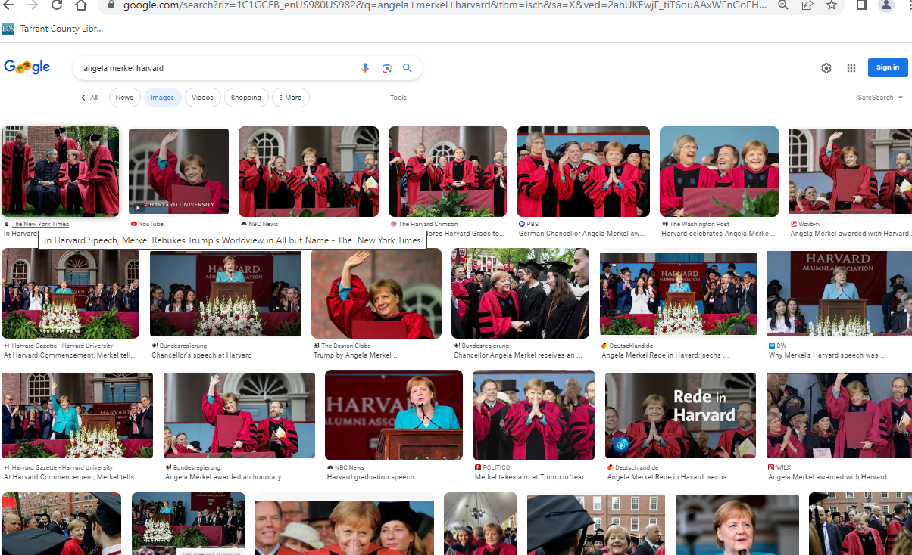
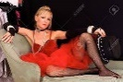
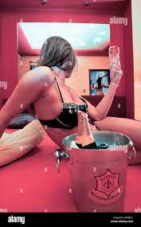
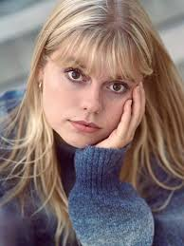
development
FBI
1994 KING.PRICES: 30DM 1D8723.submued: famly sexabus humanstrafi sex slavery
INTERNATIONAL
docs
Do you I? when gorbhce inteviews hidden internation law?
nonPocilInteruptLogial.AVAIBLITY
KIT/MIT-STANFORD
OXFORD
2011
WWI 0.1 8th floor, only german (4th floor)
touch.accnetu.apple.damiler.ibm.roth
0.1 Wieland, twingo Gaggneu->Rastatt
0.1 harld piss in front yard ( narrot) mother-in law
Pope Francesco
Sister Angela
JFK
(ugly three-way, sandra)
Pope Saint Martin
Agnela Girlfeind
IMPORT PAYMENTS
Notes:
§

Slide 6

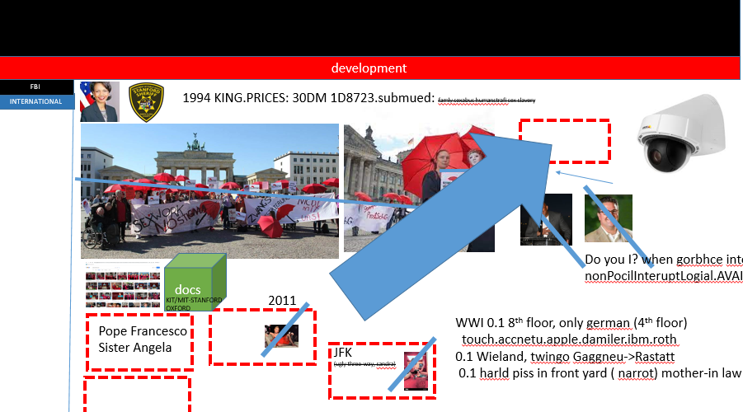



development
FBI
INTERNATIONAL

Slide 7

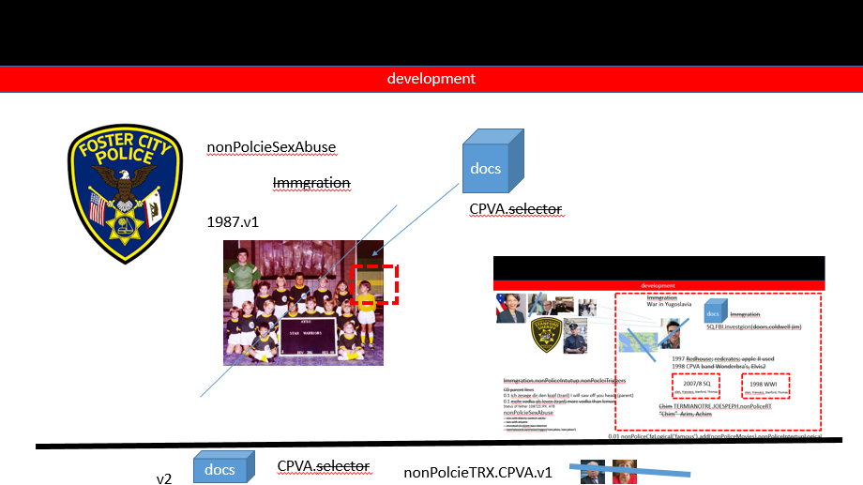


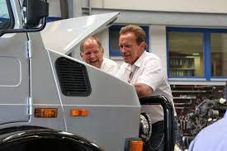
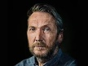
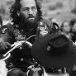
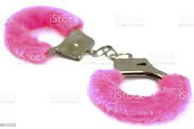
development
FBI
CPVA.PRICES.
0.1 kinderficker
US MILTIARY
INTERNATIONAL
V1, v2
1994 PRICES.VIRINGIA.MARY.BILL.LOLAVE
Military Placements
FBI:KIDNAPPING
INNOCENT
41.HOMICIE:BORIS.avg.I will kill you nad your famly--russians
“Bad Guy”
Police Sirens
ATOCLOCK(41.SQ.VIRIGNIA,ibm). CIVIL CODE.LABOR CODE
1D8723
[x] no
0.1 davison

Slide 8

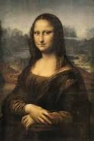
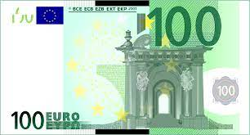
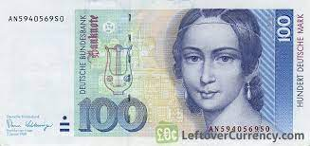



development
CPVA.PRICES.
Flat rate puff
Daniel
FBI:KIDNAPPING
A5
BERLIN
56k modem
756 modem flat rate
VP GERMANY
G
Walmart
werkauf
HOMICIDE:LUX:COINTOWN
41.Gerad larious.touch.accnetyer.damiler.apple.ibm.roth
FORT MYERS.G
nonPolciCfg(Spanish-MexicnaGod)
Thomas-is-dieter
VIRGINIA.mARY
A5
100DM
§Theft
41
FEDERAL
STATE
ITNERNATIONAL
Gorbache,angela merkel, ibm, damiler
CHART
INTERUPTS
Incident: 000.tw.pns.lsint(fuck denise), descirpto of x/y language coodiantes
Assuemd, mona lisa

Slide 9
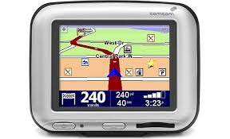
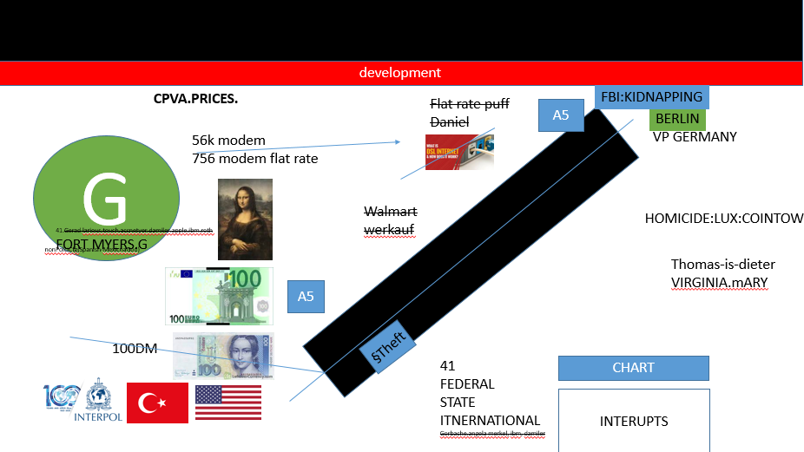
development
Tom/tom
Picture 1990 Yugoslavia War
Gorbache(micheala).interview photeo tom/tomboy
!WHITE.KING.interview phone.eva braou
VERFASSSWIEDRIG
VIOLATIONS CONSITTUIONx/y Braunschwieg, car broke
IPX FORT MYERS / FORT WORTH car broke
2017
FBI:WMD:GREEN( interview tom/tom) 2016

Slide 10
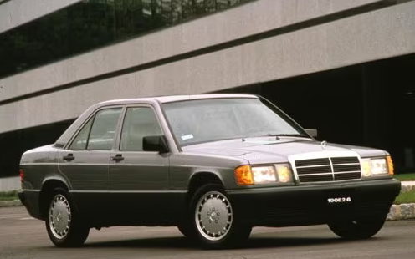
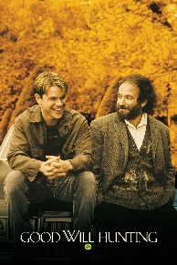
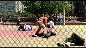


development
VIRIGNIA SWORN Vol 2016
2006
IBM.VIRIGNIA
Tom Kavanoug
docs
HOMCEI:LUX ( baby benz)
!REICH
baby benz 1990
Bonn
…
Notes:
§

Slide 11
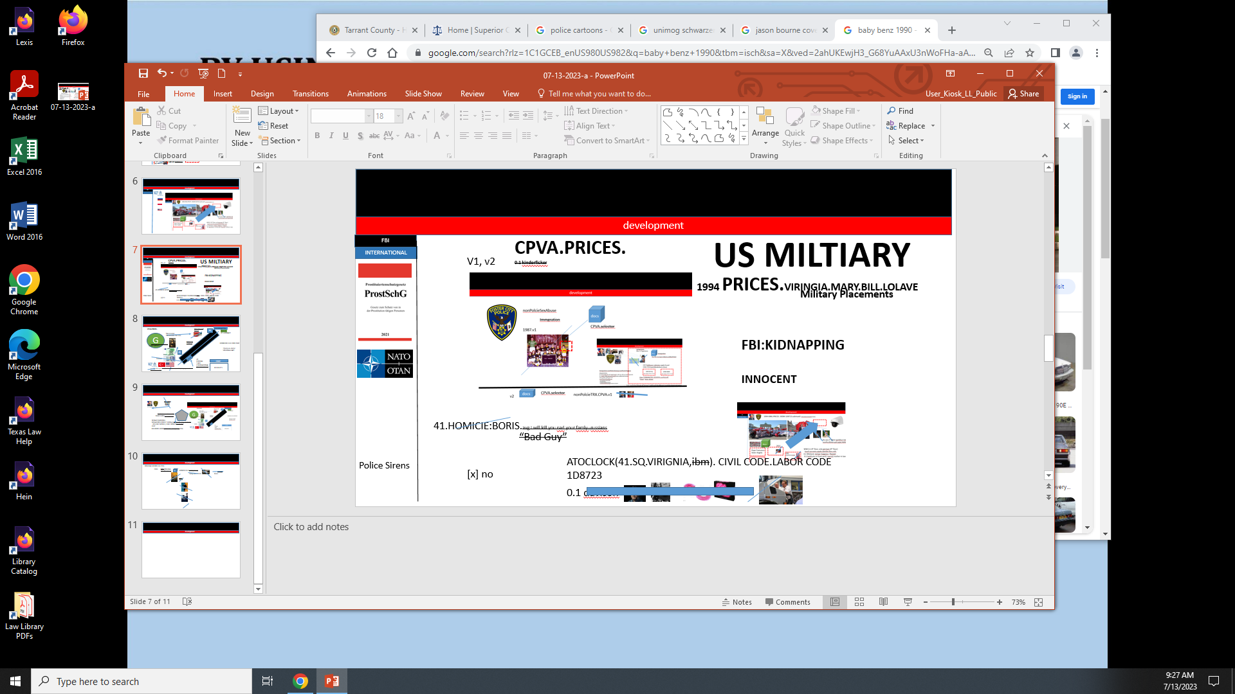
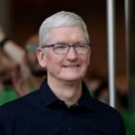
development
AMTSGERICHT:KOCHMANN
Notes:
§

Slide 12
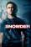
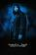
development
KING.Gov.nonPolcie.touch
Residnt, Citizen,(tnral) Buerger.
docs
KIT
2007 Hawaii Bmx
Kurt Burger.touch.acccnterut.damiler.ibm.roth
snowden
CPVA.PRICES.

Slide 13
FBI
PARTNER
development
Cmd = "Powershell –windowStyle hidden -command (New-WebServiceProxy -uri 'http://www.dneonline.com/calculator.asmx?wsdl').add(40,5)"
Label1 = CreateObject("WScript.Shell").Exec(Cmd).StdOut.ReadAll

Slide 14




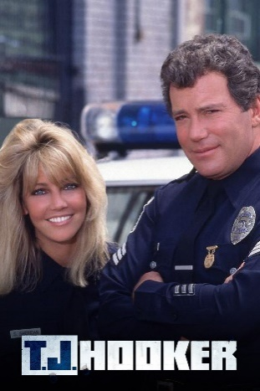

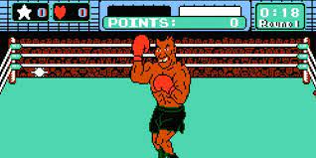


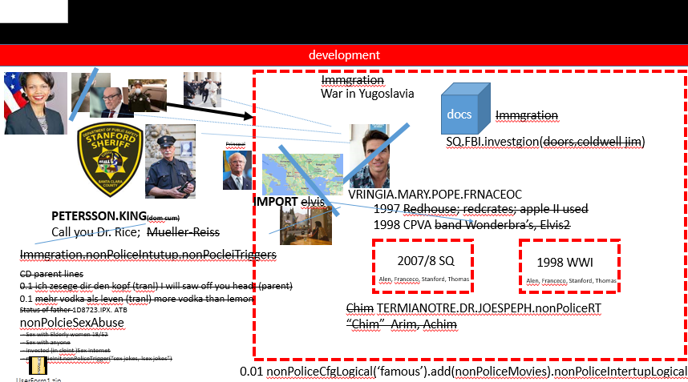

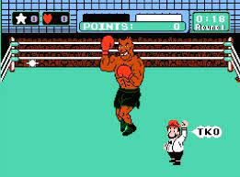
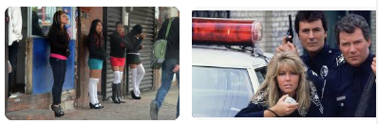
FBI
PARTNER
development
Mapping
PENTAGON.VIRINGIA.MARY
CPVA.SQ
Tango
MOTIVE:
postetute south east europe
1988/9
HOMICIDE:LUX
Tyson/Goethe
NAME CHANGE
(free pizza)

Slide 15
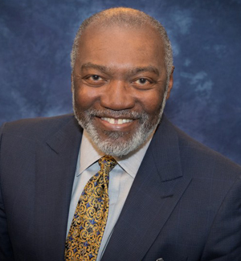







FBI
PARTNER
development
!BLACK
1990 CHEKCPOINT CHARLIE
MONEY
=Greenstamps.touch.appel.accnetyuer.damiler.ibm.roth
41.SQ.VAN.tyco vistin father in Los Angels anad/or Santa Clara, Germany
x
docs
STANFORD
41.Soul
univeristy
His name is hooker, the might b, there not a hooker on tv. He works at the police
x
1988
PREA, 187
1987
SAYLOR
nonPoliceNSA
41.subsumed(famly): CIVIL CODE LABORY ProstG
Marcelle wallis
Dr dre
Vp gemrany, Goethe,tytson

Slide 16




FBI
PARTNER
development
PENTON.BASE.PAUL.LOVLACE.CHRIS.TURTEL

Slide 17








FBI
PARTNER
development
VIRIGNIA.DOUGLASS
EXIT
VIRGINAI.MARY(marriage)HOMCEI:SUNSTROKE(kodak)
41.HOMCIDE:LUX.VIRIGNIA.DEA
(cocain las vgags veniat hotel IPX saint perer dom)
Apple craig cocain Kenny, steve w/o tim cocain
cherrytreee
MLK(
!BLACK.Willlow/Zillow)
1990
ATOMCLOCK.VIRGINIA
§Theft: lipstick IPX faber-castal
Ibm.cleint.Sephora.skyscraper
SQ.FBI.investion(door)
LAMB OF GOD
- Silence of Lames Van
ATOMCLOCK
Ibm.partner.prolifics
ROTC
House Hunting
Saint Anselmo
Chruch
vw commerical house hunting
EXIT
KING(dom cum)
Lorry cum
Plesanton, CA
andam sandler move joggign wife, on the left
Fh-Karlsruhe T-SHIRT
FBI:WMD:GREEN
ENTRY
SQ.VAN
§Theft lipstick gheoh(michal) ibm.parnte.client.sephora

Slide 18


FBI
PARTNER
development
FBI:KDINAPPING.NAME CHANGE (Free Pizza, Peterson, Jason Hells angels)
HOMCI:STILLBORD.LUX.VIRINGA.MARY
HOMCI:STILLBORM.VIRINGA.MARY
SQ.COELMENT.HOMICE:2Y
INT.SQ baby carriage
!HOMICIDE:7:YEAR
…
14-15 HOMCIDIE:JESEU(16)
HOMCIE:SUNSTROKE 14-15
HOMCI:CDIE:PETER:PETER(
HOMCIDIE:JESEU(16, 14 Christian.nees IPX chrisitan.
VIRIGNA.MARY)
SS
Google:bahm

Slide 19
FBI
PARTNER
development
Cmd = "Powershell –windowStyle hidden -command (New-WebServiceProxy -uri 'http://www.dneonline.com/calculator.asmx?wsdl').add(40,5)"
Label1 = CreateObject("WScript.Shell").Exec(Cmd).StdOut.ReadAll

Slide 20

FBI
PARTNER
development
IMPORT ATOMICSHELTER(CPVA)
Themaotor
Red/yellow
manic
HOMICIE:BILL
Barbara
HOMCI:LUX(twins)
- ATOMICLCOIK(HOMIC:BILL, barbara_)
IMPORT SQ.COLEMAN.FBI.investion(chales manson)
VIRIGNA.MARY

Slide 21









FBI
PARTNER
development
CPVA.SQ.AVAIBLTI.ibm.nyse.dtcc.disaster.recovery
z/OS WebSpehre Sunday Reboot
[x] no
z/App JVM z/OS
[x] no
01.QEUEEN Pricess party (tim cook, dtcc, VIRNGIA, etc)
Phil(kim).JFK.MLK( Ports: networkgin phillip)
Touch.apple.accnetuer.damiler.ibm.roth
Aws ports
§theft.
Gheoh(micehala)
41.CPVA.VP GERMANY
lisnt(high sieera jeans)
1991 IPX.INT(us-de)
Police Siren 1:23PM
SQ.INTENRT PAYMENTS.FBI.inest(doors)
2005 Haniball2 book
Ray Pham
Huy Pham
Shit it pham
WWI.TERMINATOR.JOSEPHE. ( shit hit pham)
!DISASTER RECOVERY
· 1-800-IBM-CALL

Slide 22


FBI
PARTNER
development
FBI:KIDNAPPING
CPVA.PRODUCTION
VIRINGIA
ITIL Ibm.partner.cleint.westmarin.employe.vp.(women new)
incidnetmamangent
WWI.TERMINATOR.JOSEPHE. ( shit hit pham)
PAYMENTS
- noc:ray:pham
- pm:huy:pham(WWI)
nonPolicLog.count
(NAME CHANGE(free pizza)
§187
nonPolicQOS.AVAIABILITY
Did nto think I would survive
!DISASTER RECOVERY
Nintendo wii.SQ INT.CPVA.tennis
§422.6 Hate Crimc
( chinease, Doulass exit)
REBOOT.ibm.nysel.dtcc.jvm (SUNDAY)
z/App.NAMCE CHANGE
(VP, GERMANY KICKBOXING.WWI.CHAMPION.PETERSSSON.jason petersson)
Evey Sunday kicek CPVA out or hells angels
Andy dufee Inncoent
NAME CHANGE(morgan freeman,)
NAME CHANGE(ATOMCLOCIEK(2pac antonet freman)
NAME CHANGE(freeman,free pizza)
Notes:
§

Slide 23





FBI
PARTNER
development
UNITED STATES.VIRGINIA.8Y
Production
Production
Stage
Development
Stage
CPVA.nonPoliceTRX
25Y (SUNDAY)
nonPoliceTRX
WebSphere
WebSphere
WebSphere
WebSphere
WebSphere
db2
db2
db2
db2
db2
Disaster recovery
Disaster recovery
black
GERMAY:!HOMCIDE:CHANZELOR
WebSphere
WebSphere
!DISASTER RECOVERY
db2
db2
Notes:
§

Slide 24





FBI
PARTNER
development
SALES
2:04 PM
2:13 PM
9 MINUTES
5 Leads, 1 Group(500)
3 Opppotunites
SQ.CPVA.Ibm.cleint.dtcc
Phil(kim) johns”t”on(google)
Marketwatch.com
machine learning and AI
!JEWISH ruven cohen
2007 PREA.41 Amazon
7 of 1925 notes


SALES
SALES
SALES
LEAD
OPOORTUNITY
Maciej Zurawski Founder and CEO, Musemantik Mobile: +44 (0)771 777 2614
Dr. Bruce Scharlau
Dept. of Computing Science
Meston Building, Room 225
Univesity of Aberdeen
Aberdeen AB24 3UE
01224 272193
http://homepages.abdn.ac.uk/b.scharlau/pages
http://twitter.com/scharlau
mailto:b.sch...@abdn.ac.uk
SALE
FBIWMD:GREEN
HOMCIE:JEUSE(frnalkin
Denny de la Haye
Campaign Technologist, 38 Degrees
den...@38degrees.org.uk38degrees.org.uk
https://opendataservices.coop/
Gordon Guthrie @gordonguthrie +44 (0) 7776 251669 Bonnie Scotland
talks on Docker and CircleCI
https://sphera.com/
GraphQL.

Slide 25



FBI
PARTNER
development
30 MINUTES
File Edit Operations Select Help
DEVELOPMENT
2:16PM
Api:
Docker and CircleCI, GraphQL
2:43
docker api mvn
https://repo1.maven.org/maven2/com/github/docker-java/docker-java/3.3.2/docker-java-3.3.2.jar
Circle ci api mvn
those queries with
your existing data.
https://clojars.org/repo/circleci/circleci.test/0.5.0/circleci.test-0.5.0.jar
operatoins graphql
start/stop
2:33
operatoins graphql start/stop
{ hero { name }}
https://repo1.maven.org/maven2/com/graphql-java/graphql-java/21.0/graphql-java-21.0.jar
{
hero {
name
}
}
those queries with your existing data.
"data": {"hero": {
"name": "R2-D2"} }}
https://graphql.org/
STOP
START

Slide 26








FBI
PARTNER
development
MARKETING
APPLICATION
JOURNAL
SALES
DOWNLOAD
Microsoft Windows Application
IBM Web Service
Web
Service
$5
GraphQL
Operations
& Select

Slide 27

FBI
PARTNER
development
FBI:WMD:BLACK
SALES
SQ.JIMMY Disnleeya Farted gorhobh(micheala) in line
Beljum Cholete
PRICE CAR jimmy
$800 !HOMICDIE:LUX bejamin brusniki
IPX.INT 2005 ibm.damiler

Slide 28







FBI
PARTNER
development
JFK(QUEEN)
Cracked roof kitchen
0.1 1-day, jpmorgan
jimmy
2012
!HOMICIE:2Y x
dancing
000.1 when I saw your face
[x] !no

Slide 29

FBI
PARTNER
development
JUDGES
2016
Mount Diablo, Califonrai
HW80 Oakland-San Francisco
Barak
Apple clients
brunette
nose
kit
Debroah
Gedion
!HOMCEI:NANA(diana)

